Slide 1
Find the most popular node using Centrality
Name - Snehal Gandham
Student Id - 79007757

Slide 2
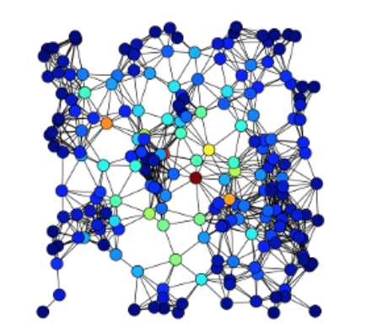
CENTRALITY
1_sgandham
In graph theory and network analysis, centrality highlights the most important vertices within a graph.

Slide 3
Variations
Total Centrality has been calculated by considering various Centralities has been considered such as
Betweenness Centrality using Brandes Algorithm
Closeness Centrality
Degree Centrality
Katz Centrality

Slide 4




applications
Find Gossipmonger / Gregarious person using Degree Centrality
Help re-route the traffic using Closeness centrality when substation goes down
Popular Person on Social Media using Degree/Betweeness Centrality
Help a scientist to find the disease causing cell using Betweenness Centrality

Slide 5
Applications
1_sgandham
In a social network, the most important people can be identified (Betweenness Centrality.
Find who can be the gossipmonger among the list of friends(Degree Centrality).
The famous celebrity among a list of celebrities can be found (Degree Centrality).
The source cell responsible for the spread of the disease can be found (Betweeness Centrality).
The substation which can face the most load in a telephone network can be found (Closeness Centrality).
Patterns of Social Relationships can be found.

Slide 6
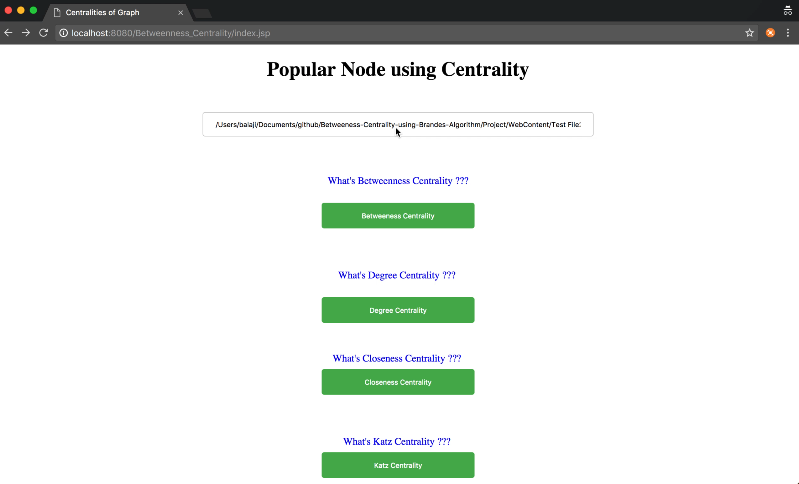
Video

Slide 7


Slide 8
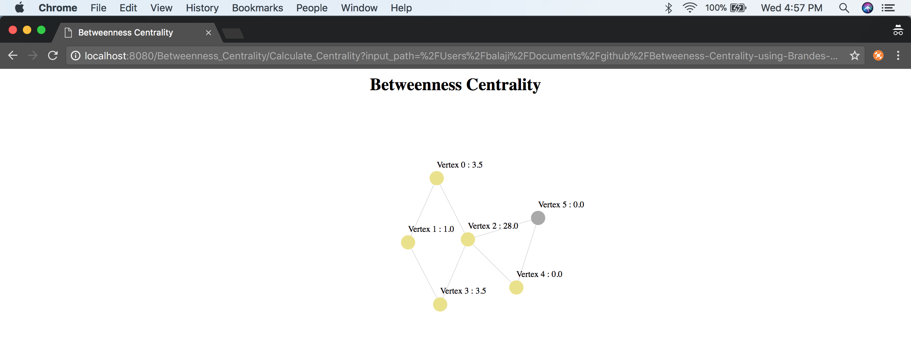
Betweenness Centrality

Slide 9
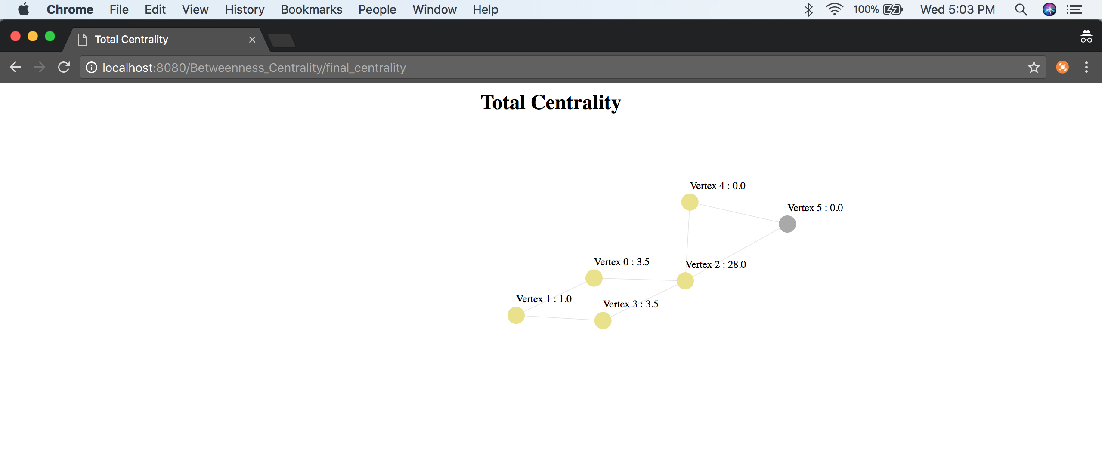
TOTAL CENTRALITY AFTER BETWEENNESS CENTRALITY

Slide 10
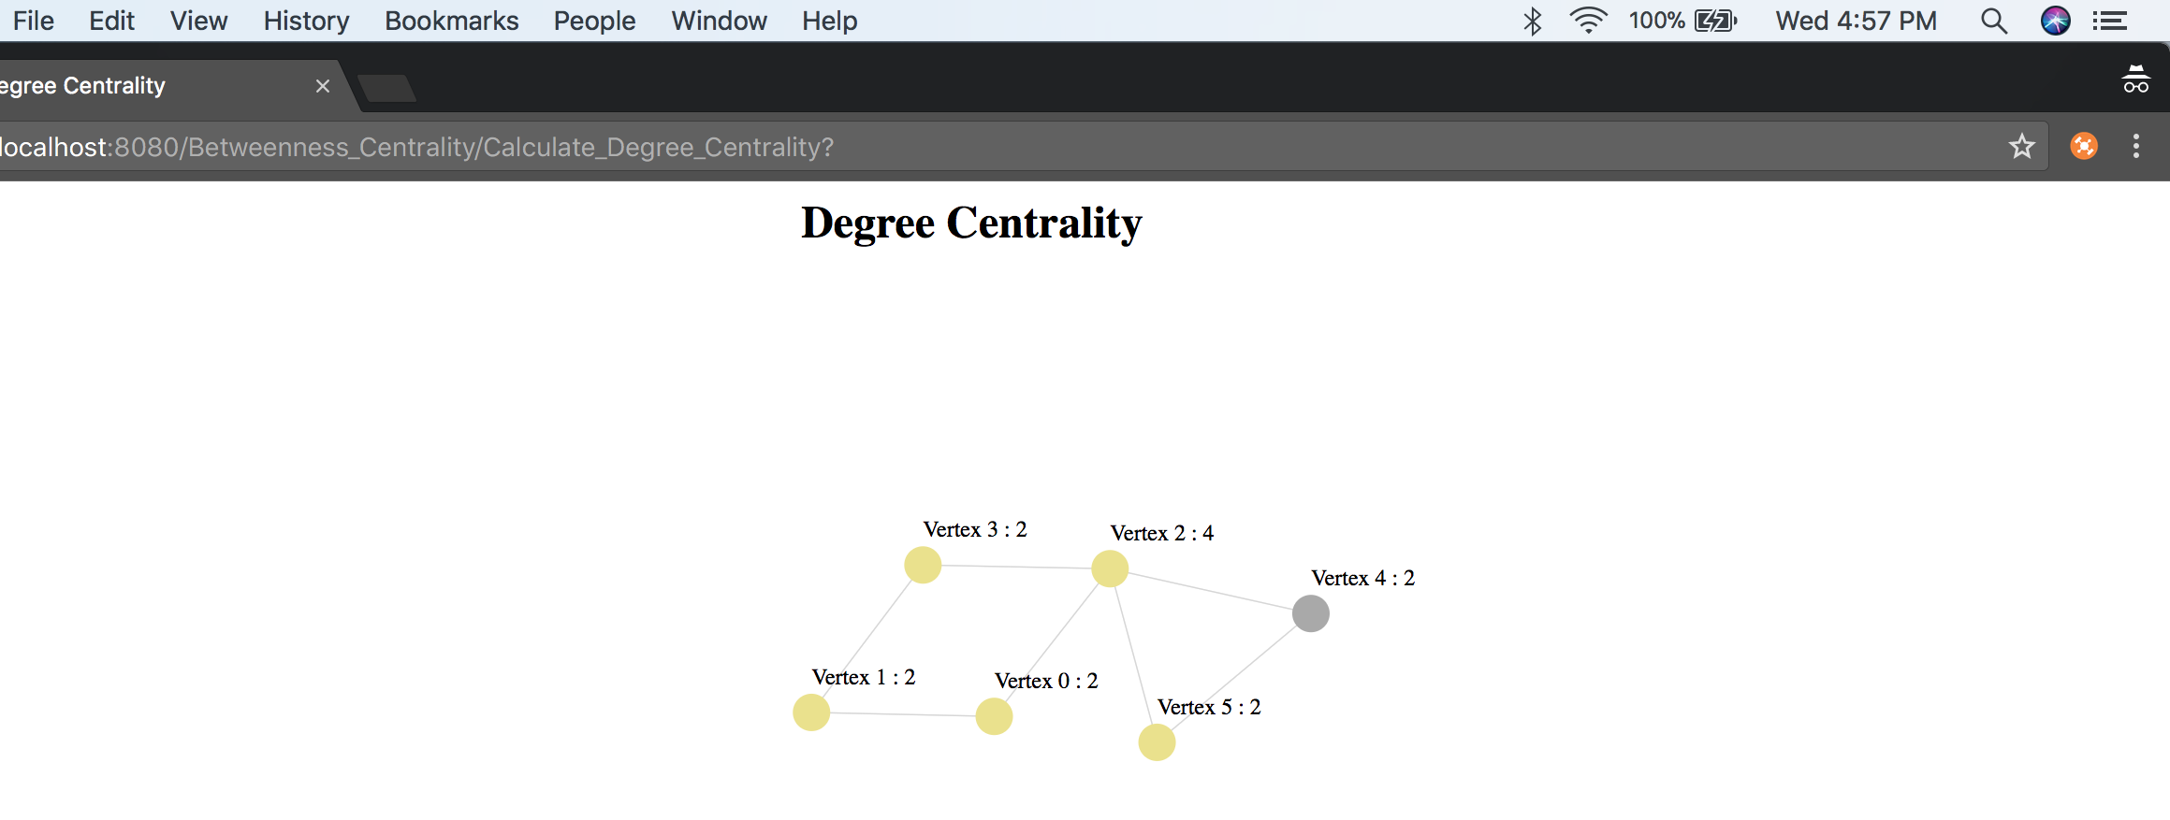
DEGREE Centrality

Slide 11
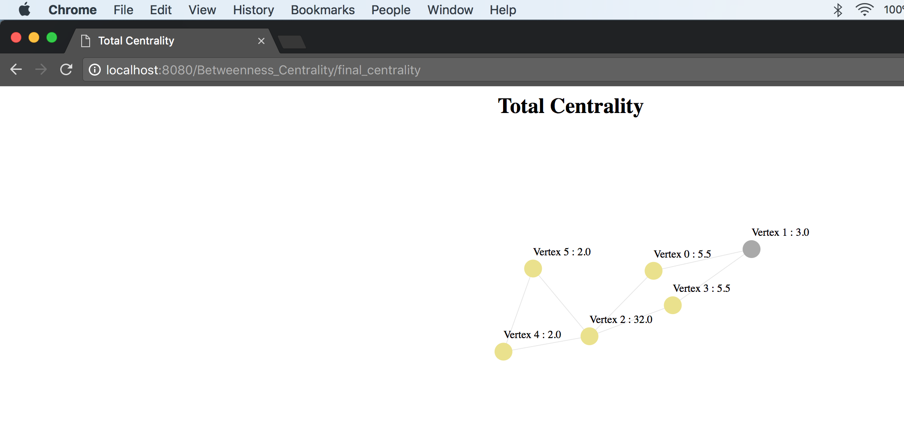
TOTAL CENTRALITY AFTER DEGREE CENTRALITY

Slide 12
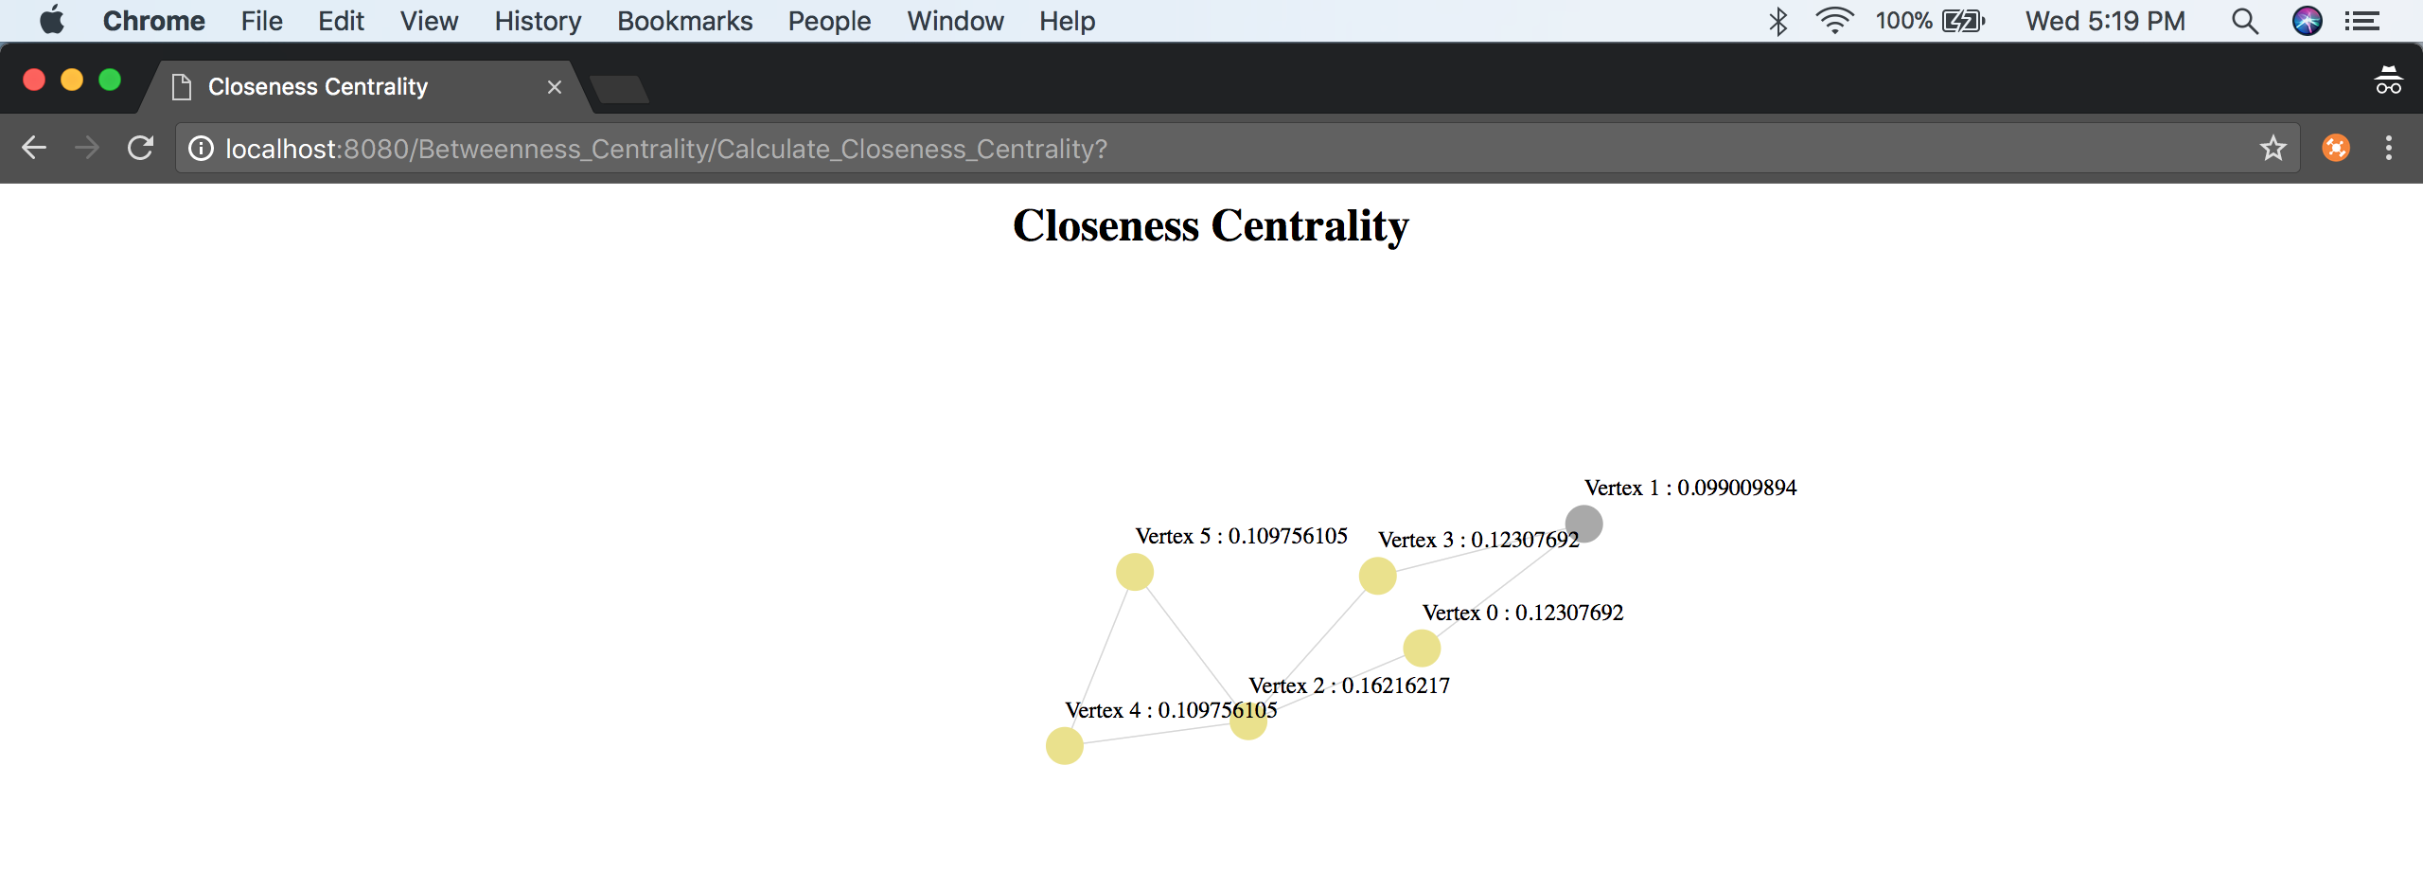
CLOSENESS Centrality

Slide 13
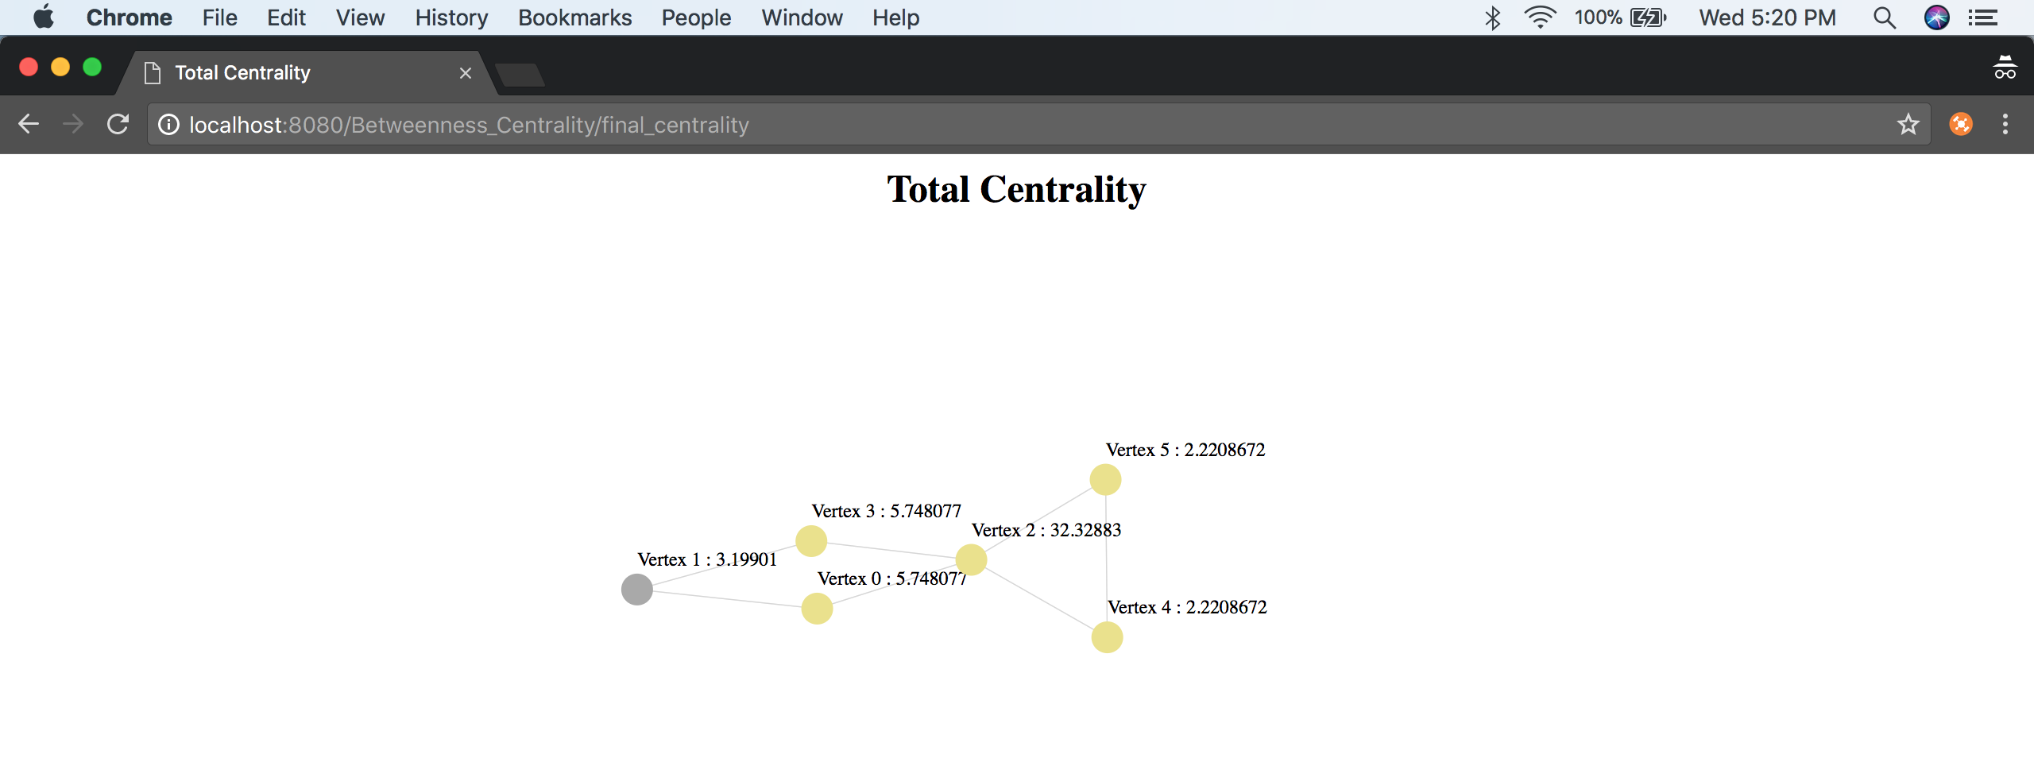
TOTAL CENTRALITY AFTER CLOSENESS CENTRALITY

Slide 14
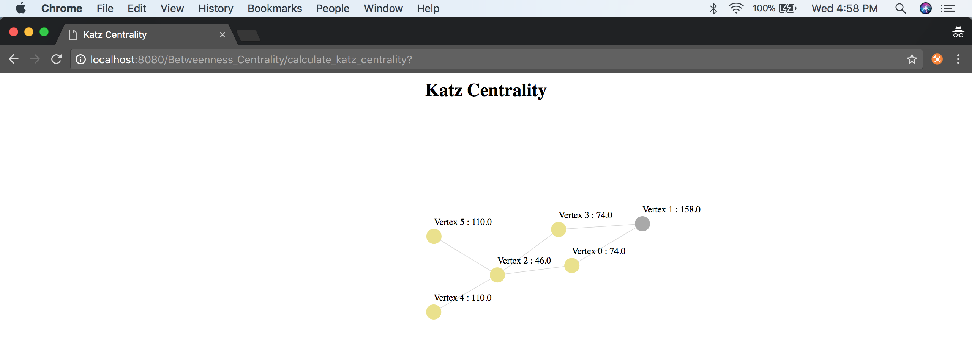
KATZ Centrality

Slide 15
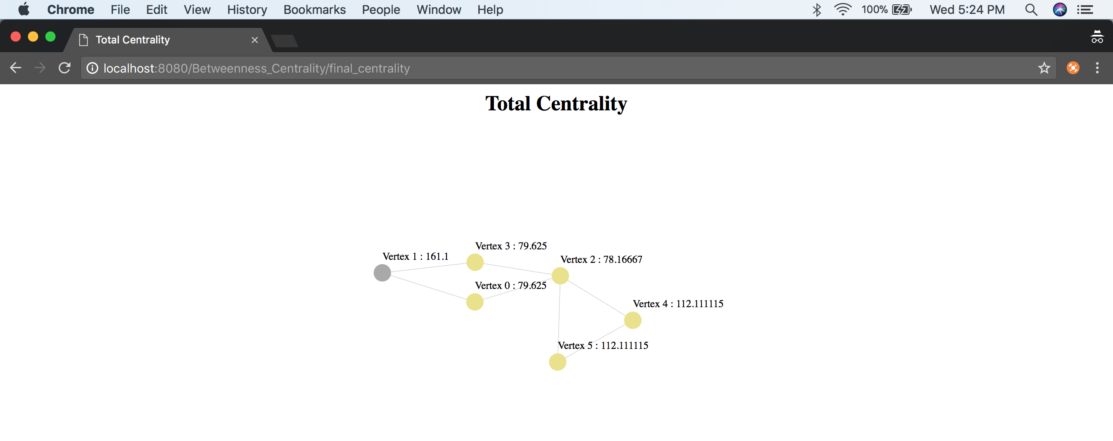
TOTAL CENTRALITY AFTER KATZ CENTRALITY

